Slide 1
What should we learn from this class?
Not Knowledge
How to use C++
How to use C++ STL
Understand the concept of stack, shortest-path algorithms, etc
”I know many things” – not important
But Design
Can you design something like C++ STL?
Are you able to develop your algorithms that are efficient?
Ask: what is missing in you, when you make all the concepts, methods, new algorithms in the textbook?
“I can design something” – Very important

Slide 2
Queues

Slide 3
Overview and Reading
Reading: Chapters: 5.2 and 5.3
First-In-First-Out Data Structure

Slide 4
The Queue ADT (§5.2)
The Queue ADT stores arbitrary objects
Insertions and deletions follow the first-in first-out scheme
Insertions are at the rear of the queue and removals are at the front of the queue
Main queue operations:
enqueue(object): inserts an element at the end of the queue
dequeue(): removes the element at the front of the queue
Auxiliary queue operations:
object front(): returns the element at the front without removing it
integer size(): returns the number of elements stored
boolean empty(): indicates whether no elements are stored
Exceptions
Attempting the execution of dequeue or front on an empty queue throws an QueueEmpty

Slide 5
Queue Interface in C++
C++ interface corresponding to our Queue ADT
Requires the definition of exception QueueEmpty
Often dequeue returns an object
template <typename E>
class Queue {
public:
int size() const;
bool empty() const;
const E& front() const
throw(QueueEmpty);
void enqueue (const E& e);
void dequeue()
throw(QueueEmpty);
};

Slide 6
Example
Operation Output Q
enqueue(5) – (5)
enqueue(3) – (5, 3)
dequeue() – (3)
enqueue(7) – (3, 7)
dequeue() – (7)
front() 7 (7)
dequeue() – ()
dequeue() “error” ()
empty() true ()
enqueue(9) – (9)
enqueue(7) – (9, 7)
size() 2 (9, 7)
enqueue(3) – (9, 7, 3)
enqueue(5) – (9, 7, 3, 5)
dequeue() – (7, 3, 5)

Slide 7
Applications of Queues
Direct applications
Waiting lists, bureaucracy
Access to shared resources (e.g., printer)
Multiprogramming
Indirect applications
Auxiliary data structure for algorithms
Component of other data structures

Slide 8
Application: Round Robin Schedulers
We can implement a round robin scheduler using a queue Q by repeatedly performing the following steps:
e = Q.front(); Q.dequeue()
Service element e
Q.enqueue(e)
Queue
Dequeue
Enqueue
Shared Service

Slide 9
Array-based Queue
Use an array of size N in a circular fashion
Three variables keep track of the front and rear
f index of the front element
r index immediately past the rear element
n number of items in the queue
normal configuration
Q
0
1
2
f
r
wrapped-around configuration
Q
0
1
2
r
f

Slide 10
Queue Operations
Use n to determine size and emptiness
Algorithm size()
return n
Algorithm empty()
return (n = 0)
Q
0
1
2
f
r
Q
0
1
2
r
f

Slide 11
Queue Operations (cont.)
Operation enqueue throws an exception if the array is full
This exception is implementation-dependent
Algorithm enqueue(o)
if size() = N − 1 then
throw QueueFull
else
Q[r] ← o
r ← (r + 1) mod N
n ← n + 1
Q
0
1
2
f
r
Q
0
1
2
r
f

Slide 12
Queue Operations (cont.)
Operation dequeue throws an exception if the queue is empty
This exception is specified in the queue ADT
Algorithm dequeue()
if empty() then
throw QueueEmpty
else
f ← (f + 1) mod N
n ← n − 1
Q
0
1
2
f
r
Q
0
1
2
r
f

Slide 13
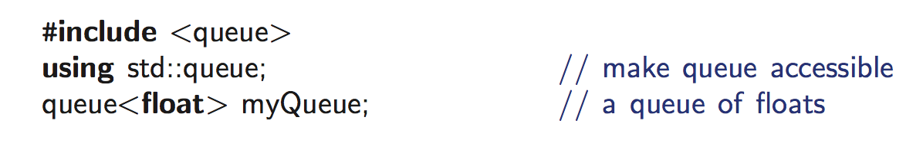
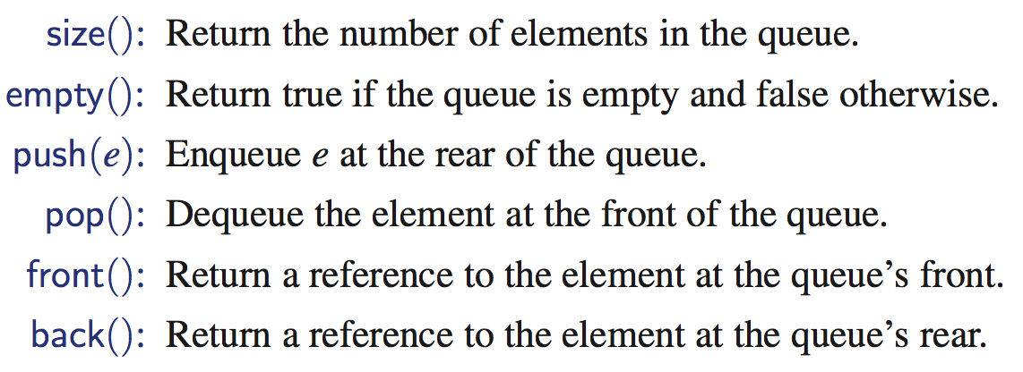
Queue in C++ STL

Slide 14
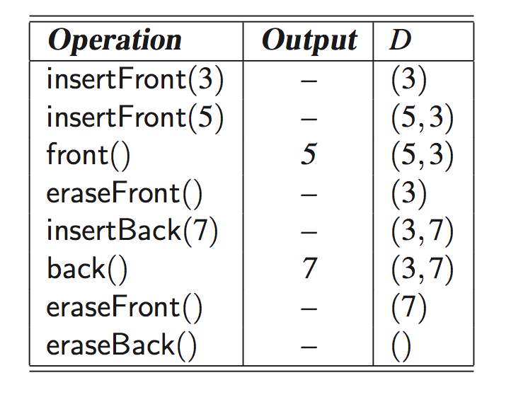
Double-Ended Queues (§5.3)
Pronounce “deck”

Slide 15
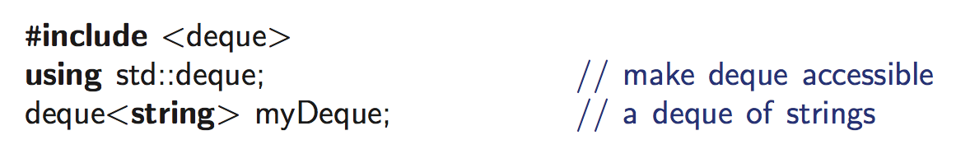
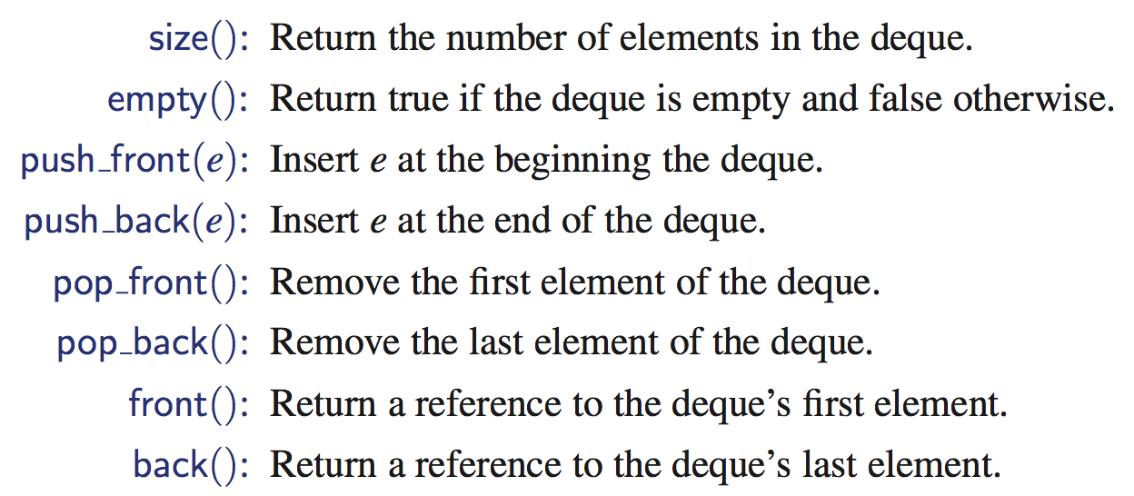
DEQUE in C++ STL

Slide 16
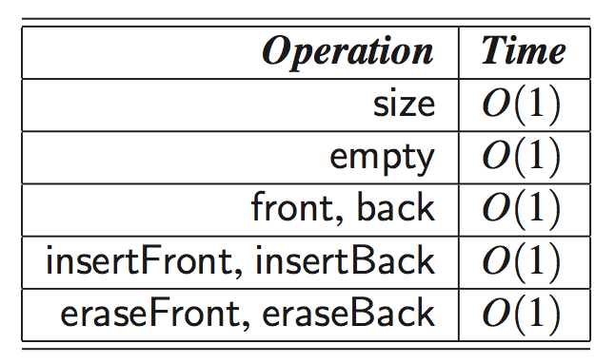
How to implement DEQUE?
Question
Which (elementary) data structure are you going to use to implement DEQUE?
Array, singly linked list, doubly linked list, circular linked list
What happens if you use others?
Deque by a doubly linked list

